Slide 1





Carbonate Clues for Hydrothermal Alteration History of Carbonaceous Chondrites
Melissa Kontogiannis
Mentor Dante Lauretta
Arizona Space Grant Consortium Student Research Symposium
Phoenix, Arizona
April 22, 2023

Slide 2
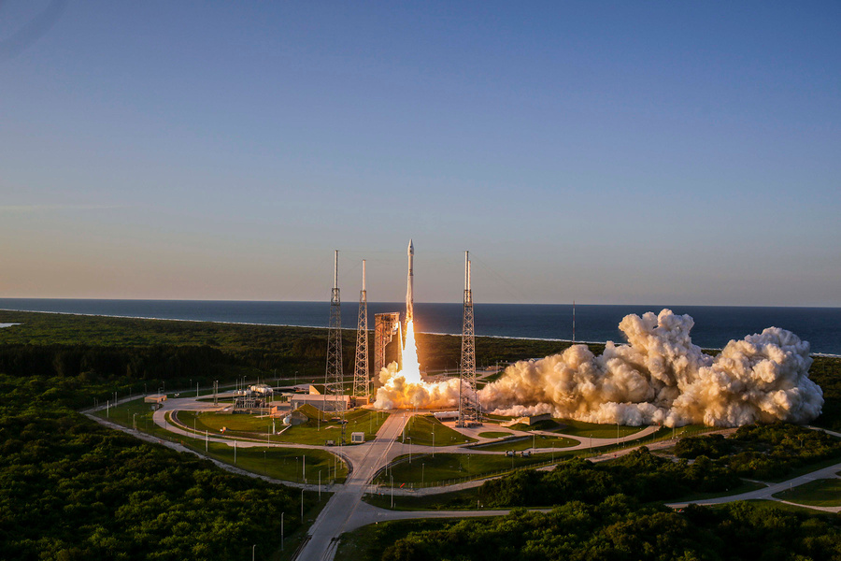
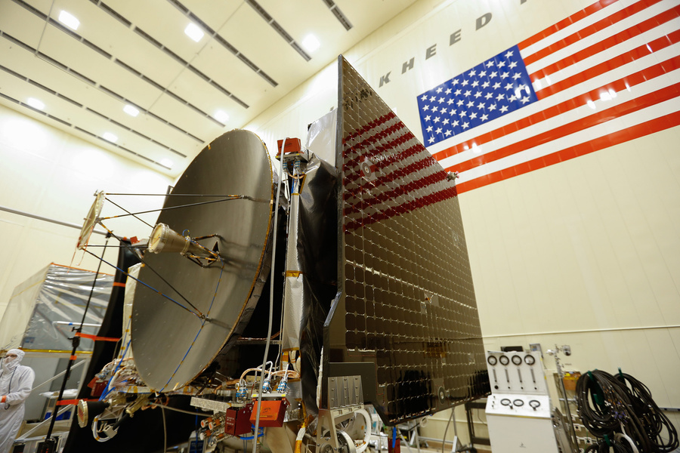
INTRODUCTION
  OSIRIS-REx Asteroid Sample Return Mission
    Goal: "collect a sample weighing at least 2.1 ounces (59.5 grams) from near-Earth asteroid 101955 Bennu and then bring the sample to Earth."
  Research related to sample analysis readiness testing and context for returned sample
Images and Quote: OSIRIS-REx Asteroid Sample Return Mission

Slide 3
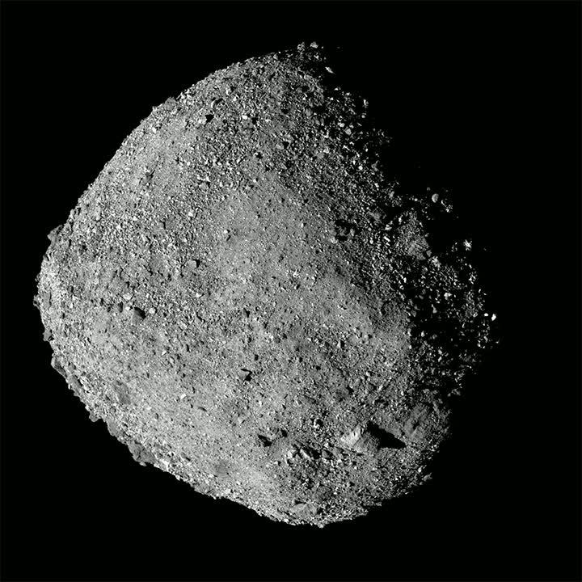
INTRODUCTION
  Asteroid Bennu
    Carbonaceous asteroid
    Among most primitive bodies in Solar System
    Contain chondrules, organic substances, and a high abundance of carbon
    Fine-grained silicate matrix
    Contain water or evidence of water
    May provide insight into the conditions and processes of the early Solar System
Image: OSIRIS-REx Asteroid Sample Return Mission

Slide 4
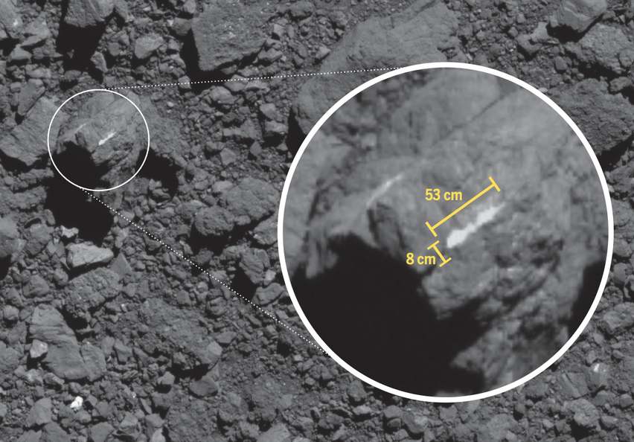
MOTIVATIONS
  Insight into parent body conditions, processes, and starting materials
  Initial focus on studying carbonates
    Carbonate veins observed on Bennu
    Sample as analog for Bennu
    Constrain composition and determine potential formation mechanisms
    Assess the plausibility of an open, large scale hydrothermal system on a parent body- would be required to create carbonate veins at the scale observed on Bennu
Image: Kaplan et al., 2022 and OSIRIS-REx Asteroid Sample Return Mission

Slide 5
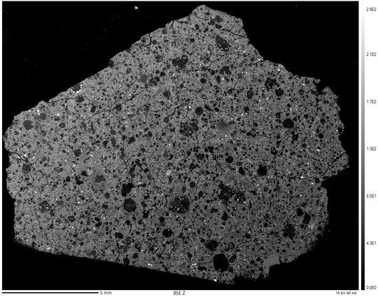
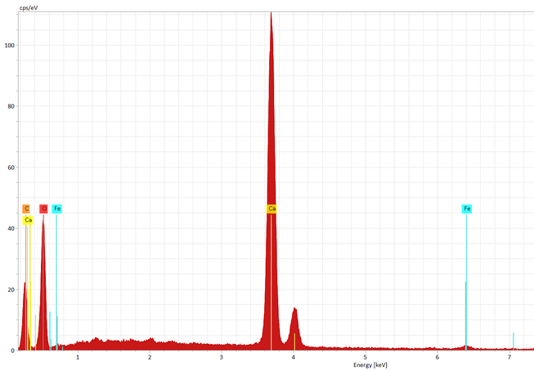
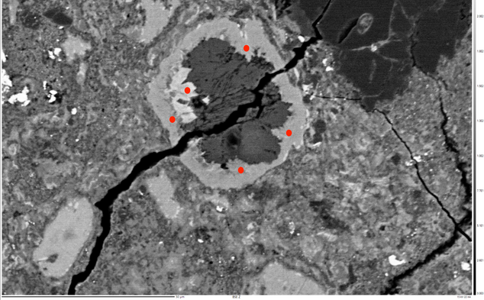
METHODS
  Meteorite Thin Section Request + Preparation
    Antarctic Meteorite LON 94102,60 from NASA JSC
  Electron Microprobe Analysis
    Backscattered Electron Images for compositional overview
      Brightness based on atomic mass
    Energy Dispersive Spectroscopy for element identification
    Wavelength Dispersive Spectroscopy for element quantification
Image: KIMCF Electron Microprobe

Slide 6
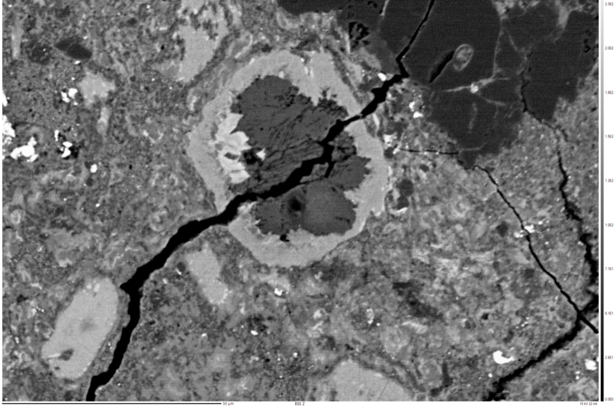
RESULTS
  Found carbonates rimmed by hydrated clay minerals and phases rich in iron and sulfur
    Evidence of aqueous processing- consistent with previous results
  Carbonate distribution and morphology
    Relatively uniform distribution with few clusters
    Small grains
    No veins
Image: KIMCF Electron Microprobe

Slide 7
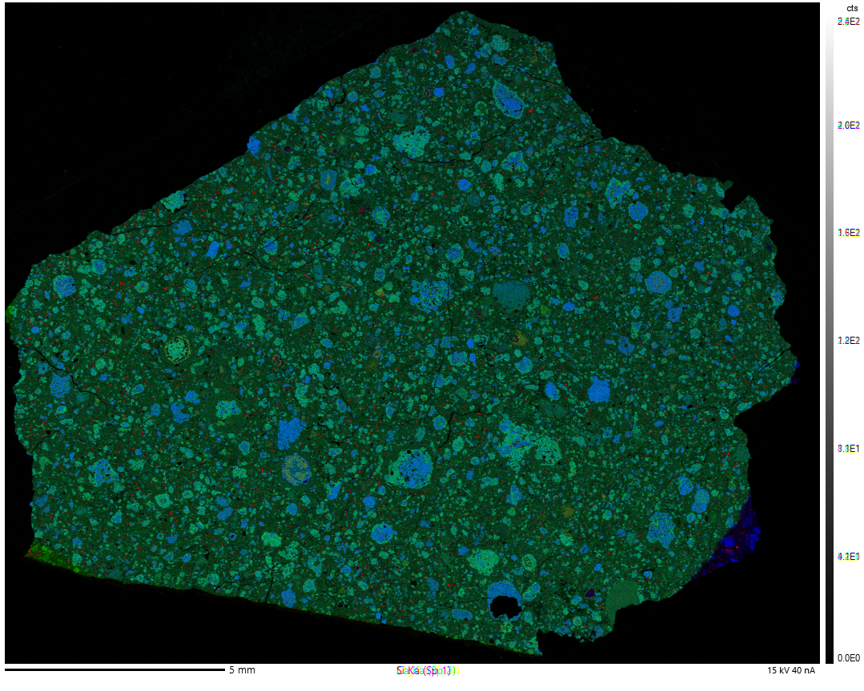
Ca
Mg
Si
Image: KIMCF Electron Microprobe

Slide 8
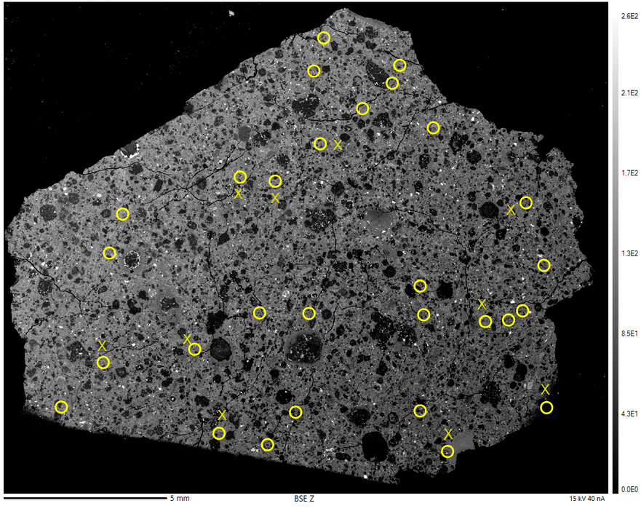
Image: KIMCF Electron Microprobe

Slide 9
MOTIVATIONS + HYPOTHESIS
  Similar processes in deep sea hydrothermal vents and parent body asteroids?
    Based on reactions observed in terrestrial environment could be analog for Bennu
      Hypothesized reaction mechanism:
        Serpentinization of olivine- forms hydrated clay rim material
        Olivine replaced by carbonate
        Rimmed carbonate assemblages left behind
    Possible model for carbonate formation on Bennu
    Link between potential origin of life environments on Earth and past conditions on parent body asteroids

Slide 10
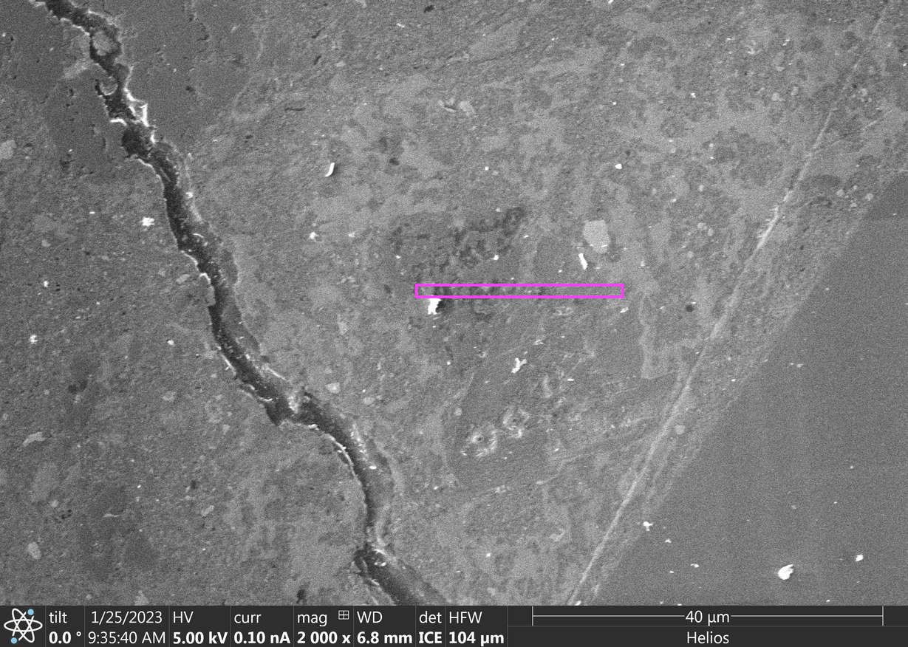
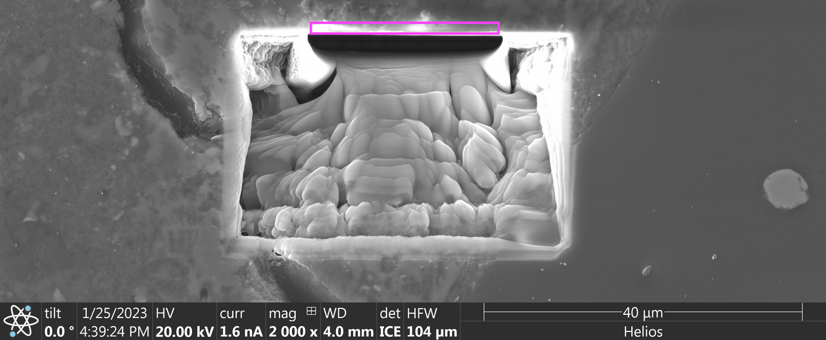
METHODS
  Focused Ion Beam Serial Sectioning
Images: KIMCF Focused Ion Beam

Slide 11
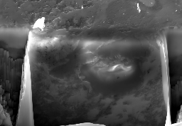
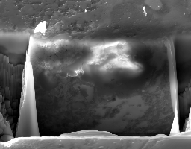
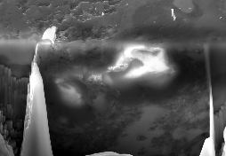
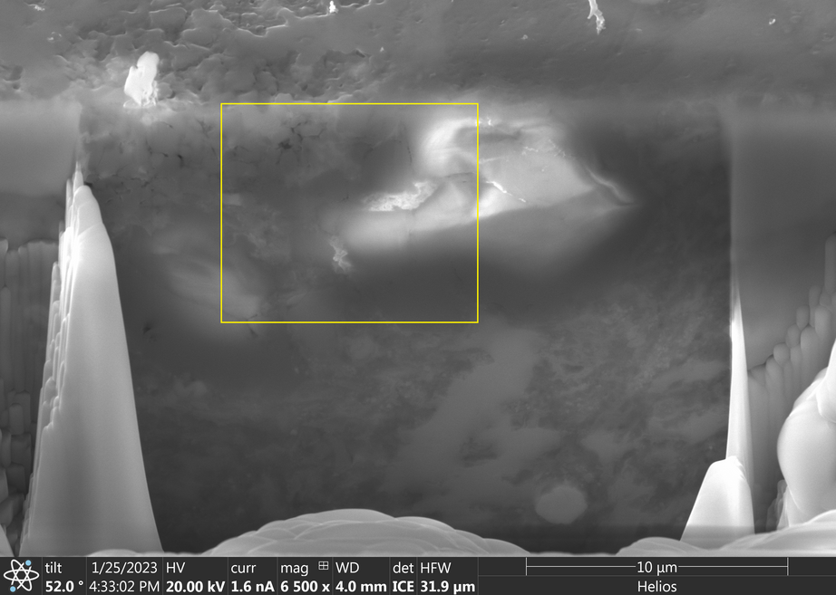
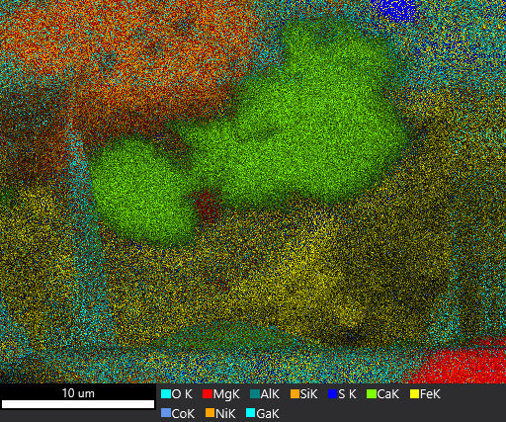
METHODS
  Focused Ion Beam Serial Sectioning
Images: KIMCF Focused Ion Beam

Slide 12
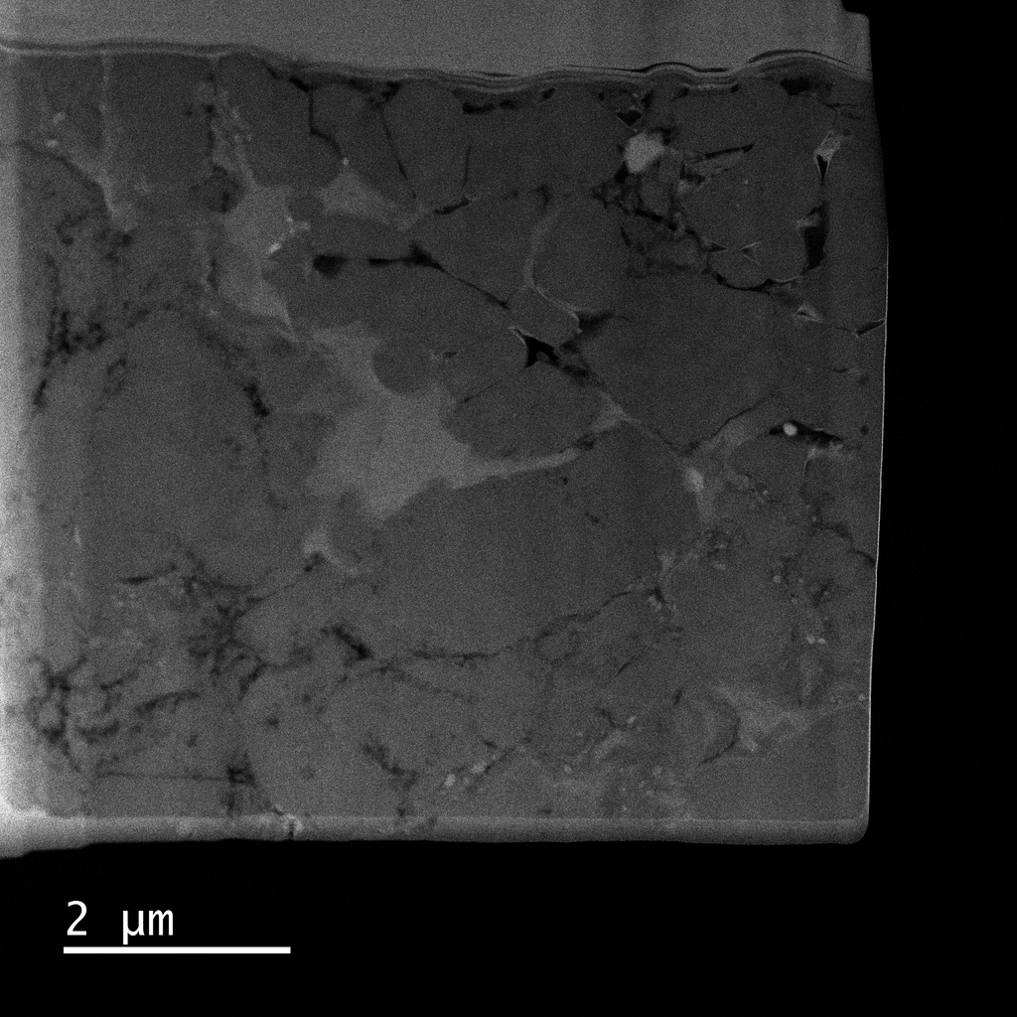
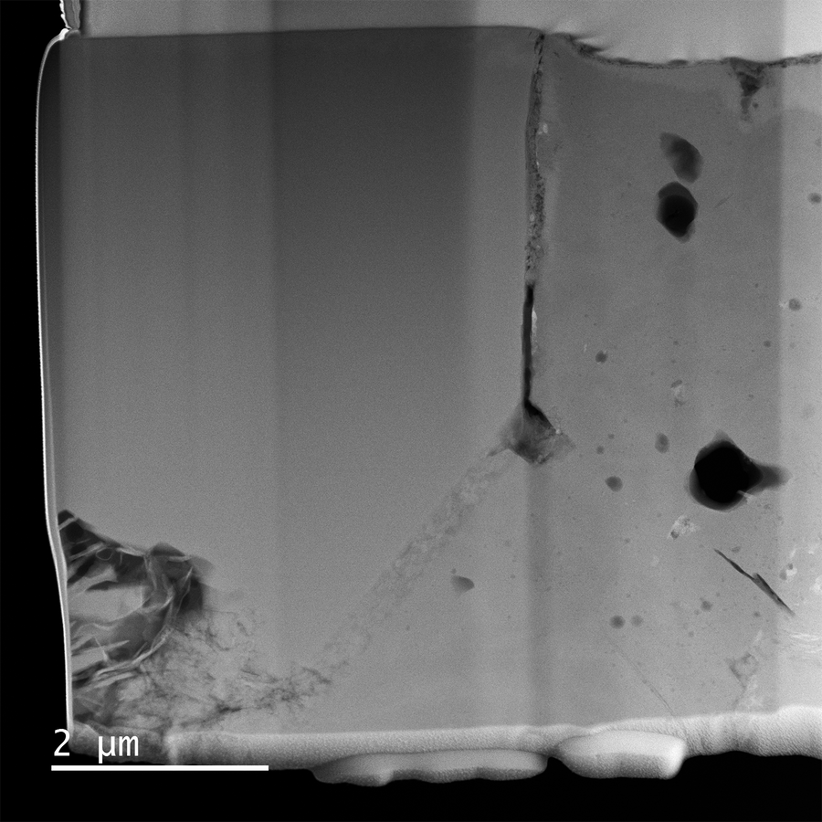
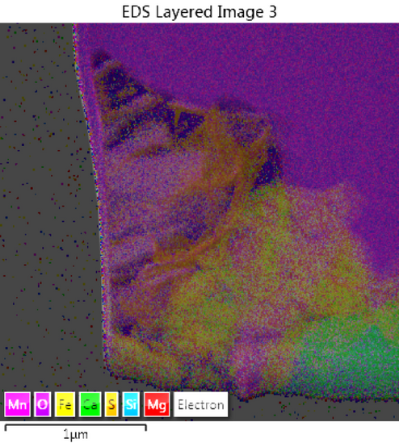
METHODS
  Transmission Electron Microscope Analysis
Images: KIMCF Transmission Electron Microscope

Slide 13
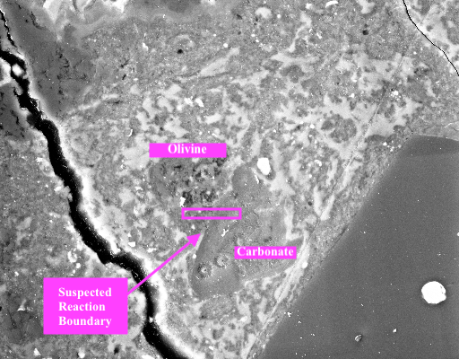
RESULTS
  Unable to confirm replacement of olivine by carbonate
    Hunt for olivine-carbonate assemblages
    Very few observed instances of spatial proximity of olivine and carbonate
Images: KIMCF Focused Ion Beam

Slide 14
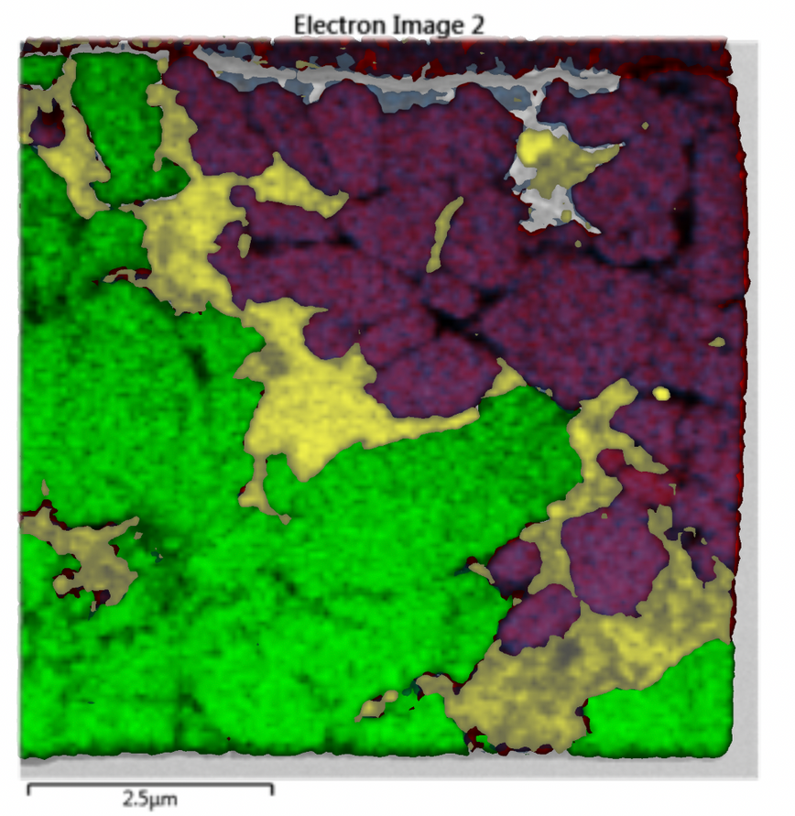
RESULTS
  Unable to confirm replacement of olivine by carbonate
    Few cases of contact did not provide any evidence of a reaction boundary
Calcite
Olivine
Fe-S phase
Images: KIMCF Transmission Electron Microscope

Slide 15
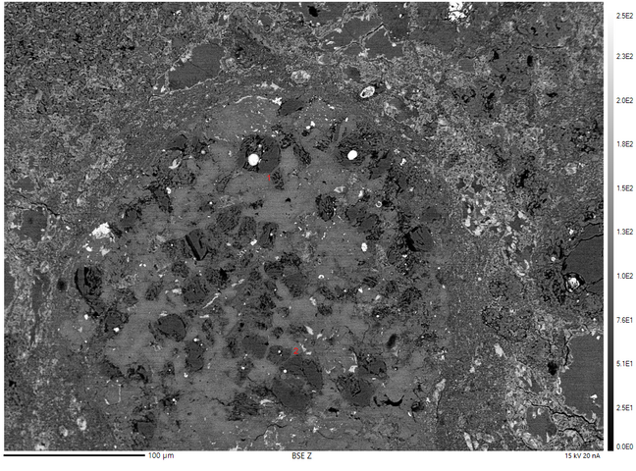
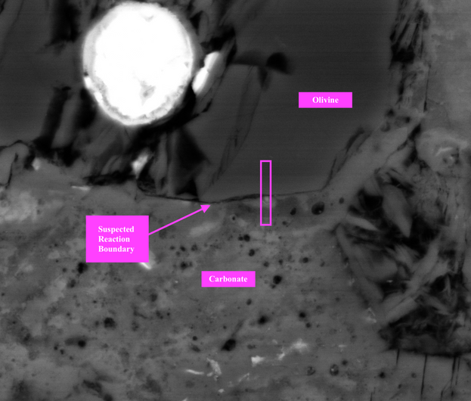
RESULTS
  Comparison to Nogoya
    Larger and more frequent associations of carbonate and olivine
    Distribution and grain boundaries suggest higher likelihood of replacement
Images: KIMCF Focused Ion Beam and Transmission Electron Microscope

Slide 16
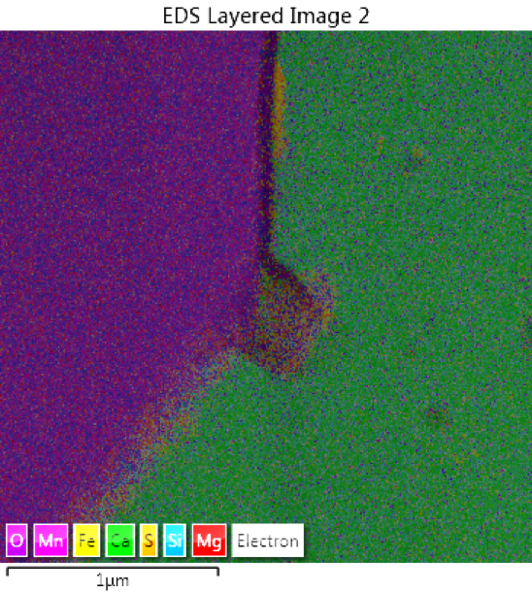
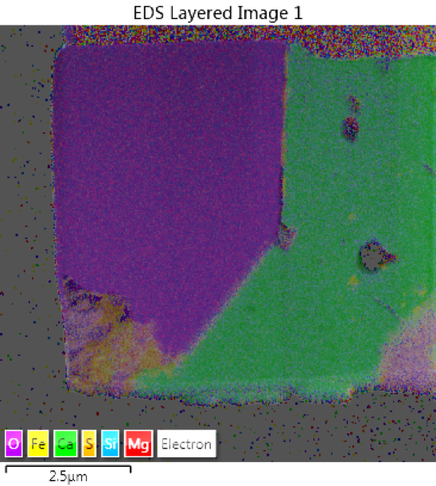
RESULTS
  Comparison to Nogoya
    Clear interface between carbonate and olivine
    Reaction boundary
    Potential mixing?
Images: KIMCF Transmission Electron Microscope

Slide 17
IMPLICATIONS
  Could not confirm hypothesis of olivine replacement by carbonate in LON 94012,60
    Can only draw conclusions for this sample- could still occur in others, and has been observed in meteorites of the same petrographic type
    Lowers likelihood that olivine is being replaced by carbonate in this sample, but cannot say for sure- we just weren't able to find it
      Though evidence is not conclusive, Nogoya sample is more convincing case for replacement
    Cannot rule out deep sea hydrothermal vents as terrestrial analog
    Still a viable hypothesis, but unable to prove in this specific case
  Carbonate morphology and distribution in sample
    Not the analog for Bennu we originally expected?
  Other mechanisms of carbonate formation still need to be investigated

Slide 18
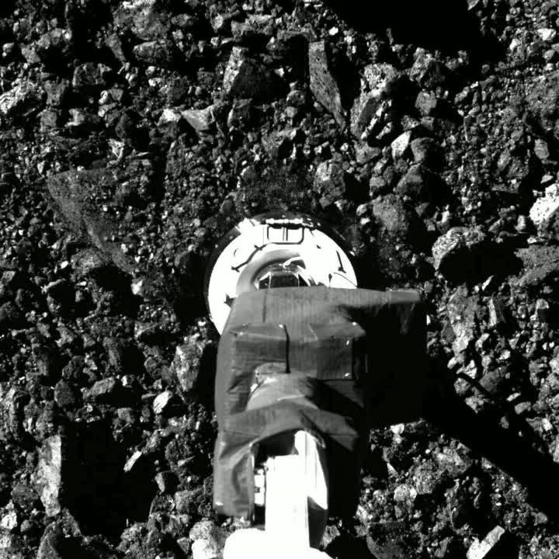
FUTURE WORK
  OSIRIS-REx sample return planned for September 24, 2023
  Working to evaluate other mechanisms of carbonate formation proposed in literature
Image: OSIRIS-REx Asteroid Sample Return Mission

Slide 19
I want to acknowledge Dr. Dante Lauretta, Sarah Nielsen, Ken Domanik, Zoe Zeszut, Dolores Hill, Jerry Chang, NASA JSC, University of Arizona LPL, KIMCF/K-ALFAA, Arizona Space Grant, and the OSIRIS-REx Mission for help, support, and guidance throughout this project!
Thank You!

